Slide 1
ML – Data Visualisation
ICT Learning Centre @ UL - Python and ML Foundations

Slide 2
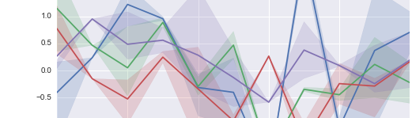
Data Visualisation
Finding the story in your data

Slide 3
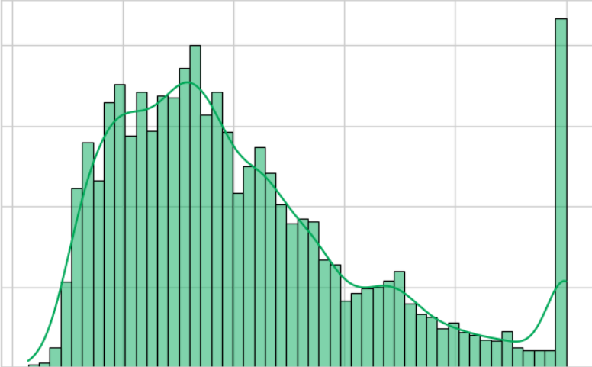
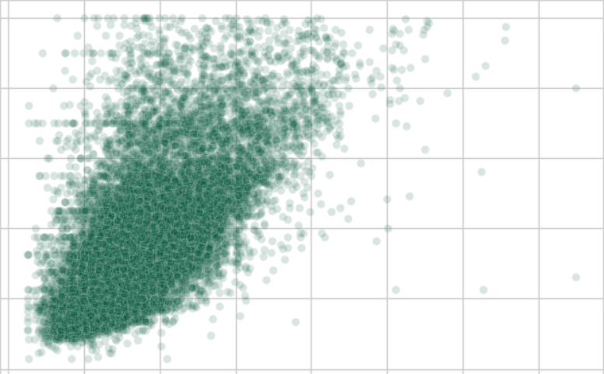
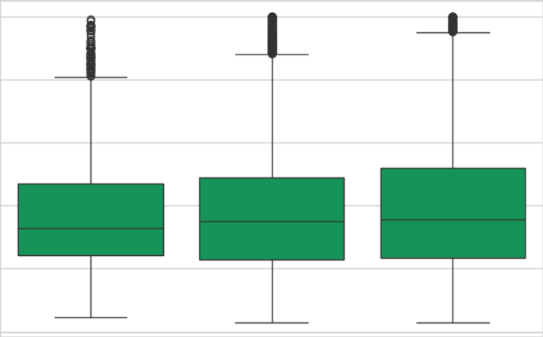
Why Visualise?
It's the first and most important step in any data project
Visuals help us instantly find
Distribution & Skew
Patterns & Relationships
Outliers & Anomalies

Slide 4



Our Toolkit
Pandas: for loading and transforming data
Matplotlib: the “foundation” of plotting and provides full control
Seaborn: Built on matplotlib; creates beautiful statistical plots with less code

Slide 5
Matplotlib
Foundation of plotting in Python

Slide 6
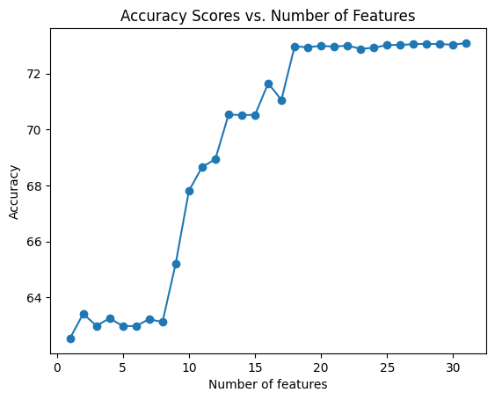
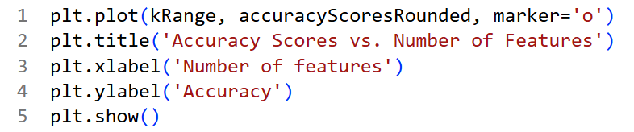
Matplotlib
Detailed, low-level control over every part of your figure.
Used via the pyplot interface, imported as plt
It is "stateful“. You build a plot layer by layer.

Slide 7
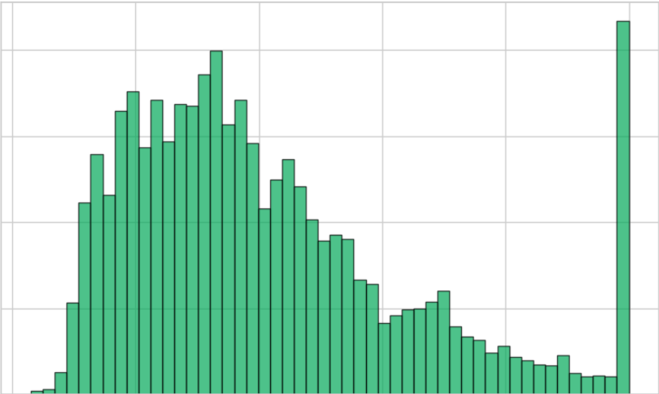
Histogram
How is the data spread out?
Helps to understand distribution and frequency of a single numerical variable.

Slide 8
Scatterplot
How are two variables related to each other?
Helps to find the relationship between two numerical variables.

Slide 9
Seaborn
High-level plotting

Slide 10
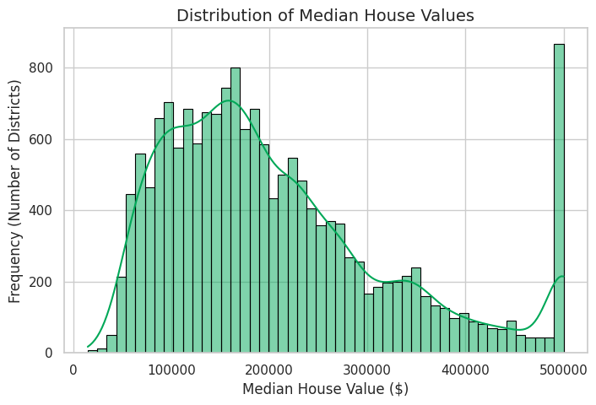
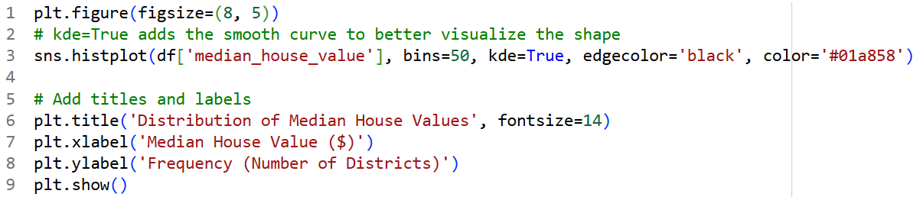
Seaborn
Built on top of Matplotlib and makes complex statistical plots simple.
It's "DataFrame-aware“.
Instead of passing data arrays like plt.hist(df['col']), you pass the entire DataFrame and the column names as strings.

Slide 11
Feature Engineering
Manipulating existing features to create new features.
Critical data science task
Example:
Objective - compare prices for 'New' vs 'Old’.
Categorise data into 3 new classes: 'New', 'Established', and 'Historic’ using ‘housing_median_age’ feature.

Slide 12
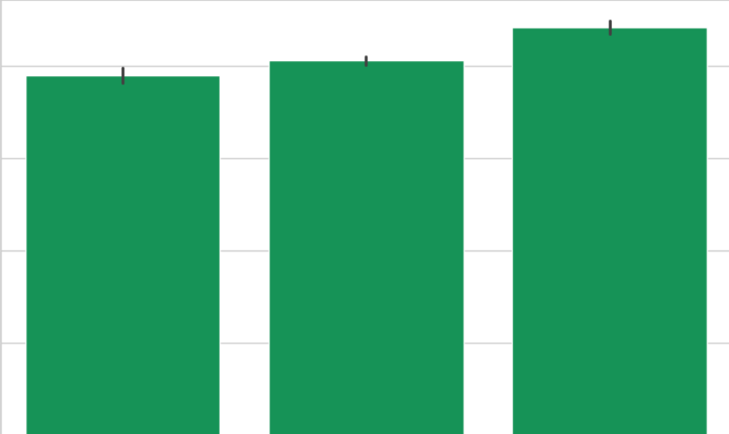
Bar Plot
How do the new house age groups compare?
Helps to compare frequencies/counts of categorical variables.
Seaborn’s advantage: automatically groups data.

Slide 13
Box Plot
Shows the spread and centre of a dataset using five key numbers: minimum, first quartile (Q1), median (Q2), third quartile (Q3), and maximum
Length of the box and whiskers indicate data spread
Dots outside the whiskers indicate outliers

Slide 14
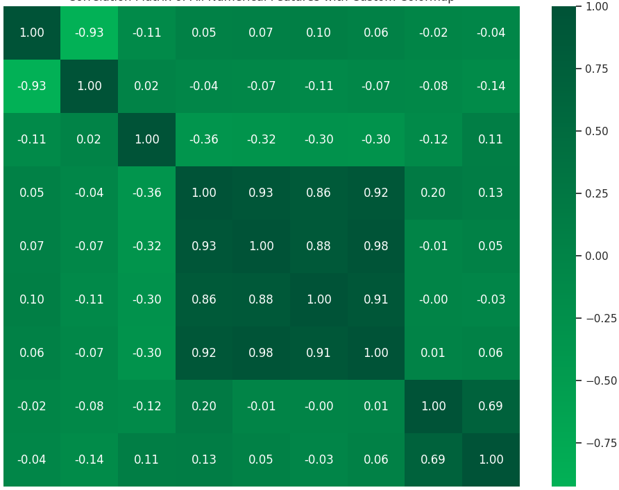
Heatmap
What are the strongest patterns in the entire dataset?
Visualises correlation matrices

Slide 15
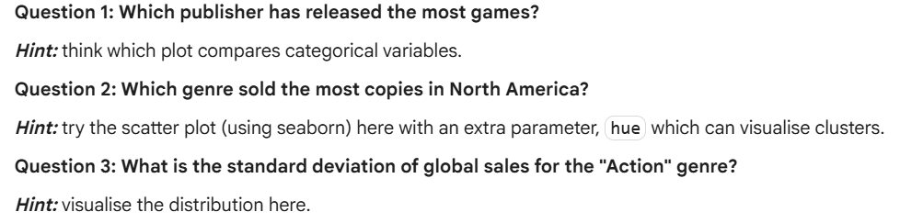
Practice Question
Visualise video game sales data from last week’s challenge question
Answer the three analytical questions, but with visual evidence.

Slide 16
Thank you
ICT Learning Centre,
CS1-046,
CSIS Building,
University of Limerick,
http://ictlc.ul.ie/contactus

